Slide 1


21CSA697A –
Minor Project
DATE :
17th Feb 2026
INTRODUCTION
FORNEW EMPLOYEES

Slide 2
Fake News Detection using Machine Learning
Name: SONA SURESH
Register No: AA.SC.P2MCA2474079
Program & Specialization: MCA IN ARTIFICIAL INTELLIGENCE
Semester : 3rd
Department: Computer Science
Institution: Amrita Vishwa Vidyapeetham, Amritapuri Campus

Slide 3
Introduction
Fake news detection comes under Natural Language Processing (NLP)
It involves analyzing textual data to identify misleading or false information
Machine learning models are used to classify news based on content
The increasing use of online news platforms has led to rapid spread of fake news
Fake information can influence public opinion and decision-making
Manual verification of news is difficult due to large volume of data
This motivated the use of machine learning to automate fake news detection

Slide 4
Problem Statement
The spread of fake news has increased rapidly through online platforms
Identifying fake news manually is difficult and time-consuming
There is a need for an automated system to classify news as fake or real
This project addresses the gap by using a lightweight machine learning approach
The use of TF-IDF with Naive Bayes provides an efficient and easily understandable solution for fake news detection

Slide 5
Objectives
Align objectives with the problem statement
To preprocess and clean textual news data
To convert text into numerical features using TF-IDF
To implement Naive Bayes classifier for text classification
To evaluate the model using accuracy as a performance metric
To understand the application of machine learning in NLP problems

Slide 6
Scope of the Project
The project focuses on detecting fake news using machine learning techniques
It is limited to text-based news articles
Classification is performed using TF-IDF feature extraction
Naive Bayes algorithm is used for news classification
The project is implemented in Python using Jupyter Notebook
The project does not include real-time data fetching or deployment

Slide 7
Literature Review / Existing System
Fake news detection has been widely studied using machine learning techniques.
Earlier approaches used manual verification and rule-based systems
Recent studies focus on text classification using NLP methods
Commonly used algorithms include Naive Bayes, SVM, and Logistic Regression
Feature extraction techniques like Bag of Words and TF-IDF are widely adopted
This project follows a traditional and effective ML-based text classification approach

Slide 8
Proposed System
An automated system to detect fake news using machine learning
Input: News article text
Output: Classification as Fake or Real
Uses text preprocessing and feature extraction
Applies Naive Bayes classifier for prediction

Slide 9
Architecture
User provides news text dataset
Text is cleaned and preprocessed
Features are extracted using TF-IDF
Naive Bayes model classifies the news
News Dataset
↓
Text Preprocessing
↓
TF-IDF Feature Extraction
↓
Naive Bayes Classifier
↓
Fake / Real Prediction
Raw text → Cleaned text → Numerical vectors → Model prediction

Slide 10
Methodology / Algorithms
Dataset collection
Text preprocessing (cleaning, normalization)
Feature extraction using TF-IDF
Dataset splitting into training and testing sets
Model training using Naive Bayes
Performance evaluation using accuracy

Slide 11
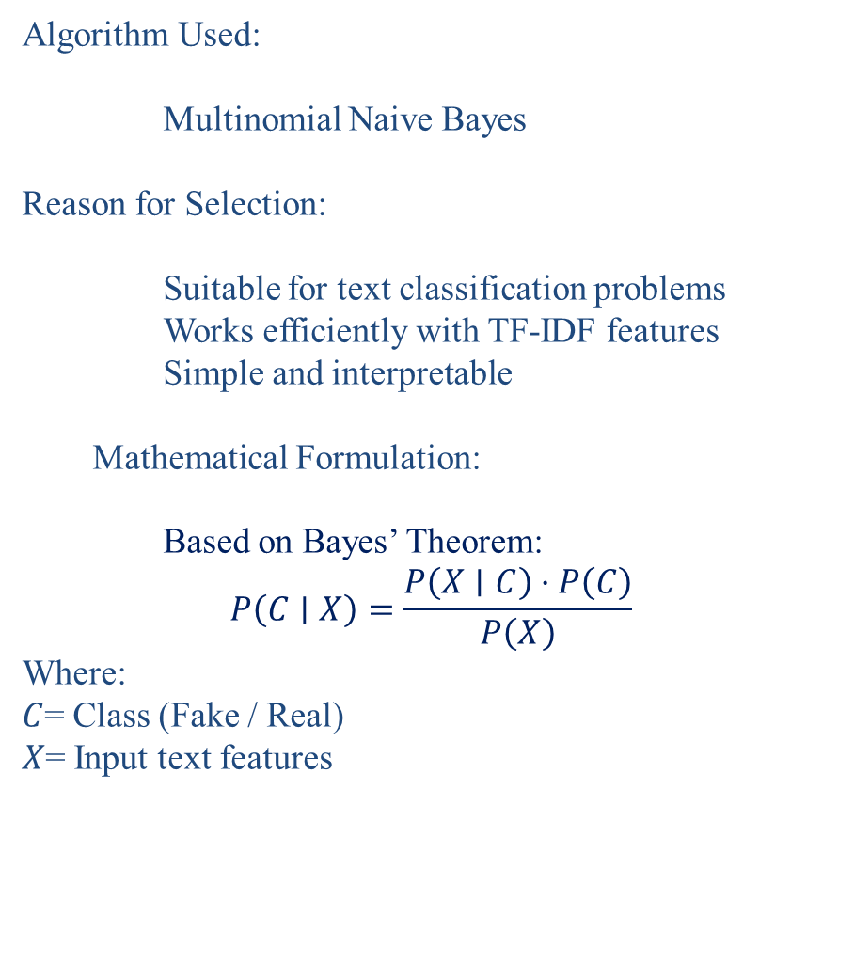
Implementation Details
Algorithm Used:
Multinomial Naive Bayes
Reason for Selection:
Suitable for text classification problems
Works efficiently with TF-IDF features
Simple and interpretable
Mathematical Formulation:
Based on Bayes’ Theorem:
$$P\left(C∣X\right)=\frac{P\left(X∣C\right)⋅P\left(C\right)}{P\left(X\right)}$$
Where:
$C$= Class (Fake / Real)
$X$= Input text features
Parameter Selection:
Default parameters from Scikit-learn
Train-test split ratio: 80:20
Random state fixed for reproducibility

Slide 12
Dataset Description
Dataset Details:
Contains news text and corresponding labels
Labels:
0 → Fake News
1 → Real News
Preprocessing Steps:
Conversion to lowercase
Removal of unnecessary symbols
Text cleaning
Feature vector creation using TF-IDF
Train-Test Split Strategy:
80% data used for training
20% data used for testing

Slide 13
Implementation Details
Tools and Frameworks:
Python
Jupyter Notebook
Libraries Used:
Pandas – data handling
NumPy – numerical operations
Scikit-learn – ML algorithms and evaluation
Module-wise Implementation:
Data loading module
Text preprocessing module
Feature extraction module
Model training module
Evaluation module

Slide 14
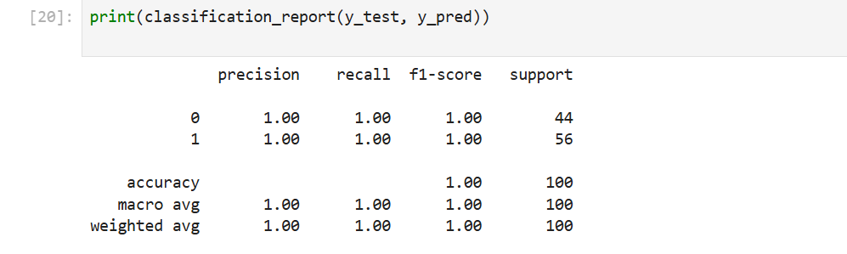
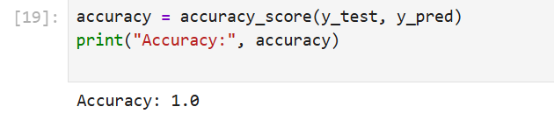
Results & Output
Quantitative Results:
Accuracy achieved: 1.0
Model correctly classified test samples

Slide 15
Testing & Validation
Test Cases:
Tested on unseen test data
Verified predictions against actual labels
Error Analysis:
No misclassification observed in test data
High accuracy due to dataset characteristics
Robustness Checks:
Model tested using random train-test split
Consistent results obtained

Slide 16
Conclusion and Future Enhancements
Conclusion:
Successfully implemented fake news detection system
Machine learning effectively classified news articles
TF-IDF with Naive Bayes proved efficient
Future Enhancements:
Use deep learning models (LSTM, BERT)
Train on larger and real-time datasets
Support multilingual news
Deploy as a web application

Slide 17
References
Scikit-learn Documentation
Research papers on Fake News Detection
Online Machine Learning and NLP resources

Slide 18
THANK YOU
onlineamrita.com

